Slide 1
Requirement Engineering Process

Slide 2
Requirements Engineering
Establishing what the customer requires from a software system
    what is it?
An important life cycle phase
Consists of two distinct activities
  - Requirements gathering and analysis
      - Requirements specification
Notes:
Objectives:
To introduce the notion of requirements engineering
To explain why requirements at different levels of detail are needed
To describe how the system requirements document may be organised
To describe the requirements validation process
To explain why requirements evolve during the lifetime of a system

Slide 3
Output of Requirements Analysis and Specification Stage
Software Requirements Specification (SRS) Document:
serves as contract between the customer and the developers.

Slide 4
What is a requirement?
It may range from a high-level abstract statement of a service or of a system constraint to a detailed mathematical functional specification
This is inevitable as requirements may serve a dual function
  May be the basis for a bid for a contract - therefore must be open to interpretation
  May be the basis for the contract itself - therefore must be defined in detail
  Both these statements may be called requirements

Slide 5
Requirements definition/specification
Requirements definition
  A statement in natural language plus diagrams of the services the system provides and its operational constraints. Written for customers
Requirements specification
  A structured document setting out detailed descriptions of the system services. Written as a contract between client and contractor
Software specification
  A detailed software description which can serve as a basis for a design or implementation. Written for developers
Notes:
Also other ways to use these terms,
and to distingiuish the different kind of reqirements documents.
Important question:
- who is the reader of the document?
Developer
Computer
Customer, manager
End-user
- why / what for does he read the document?

Slide 6
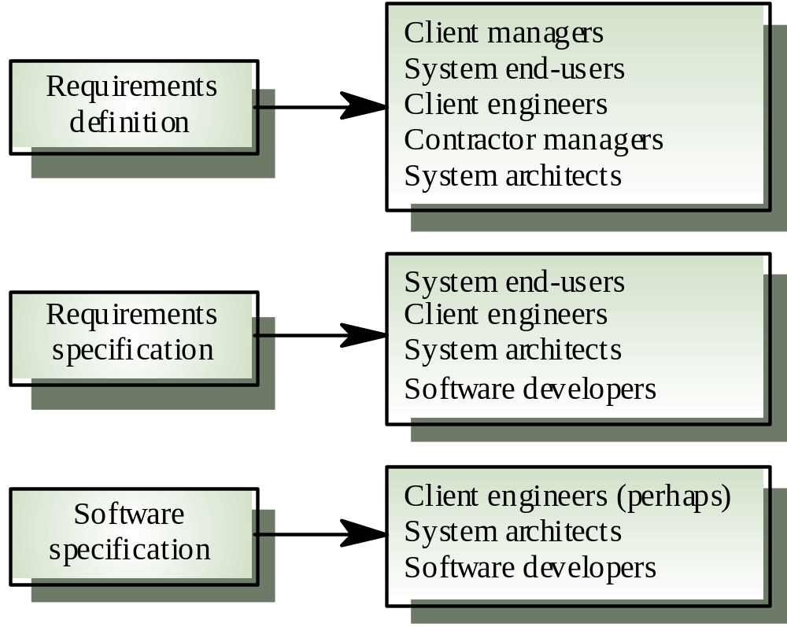
Requirements readers

Slide 7
The requirements engineering process
Feasibility study
  Find out if the current user needs be satisfied given the available technology and budget?
Requirements analysis
  Find out what system stakeholders require from the system
Requirements definition
  Define the requirements in a form understandable to the customer
Requirements specification
  Define the requirements in detail

Slide 8
Requirement Engineering Process
Feasibility Study:
- Does the system contribute to the overall objective of the Organization ?
- Can the system be implemented with current technology, specified cost and schedule constraints ?
- Can the system be integrated with the other systems which are already in place ?
- Requirement Elicitation and Analysis
- Interaction with the customer to understand the domains, scenarios, viewpoints, ethnograpfy etc.

Slide 9
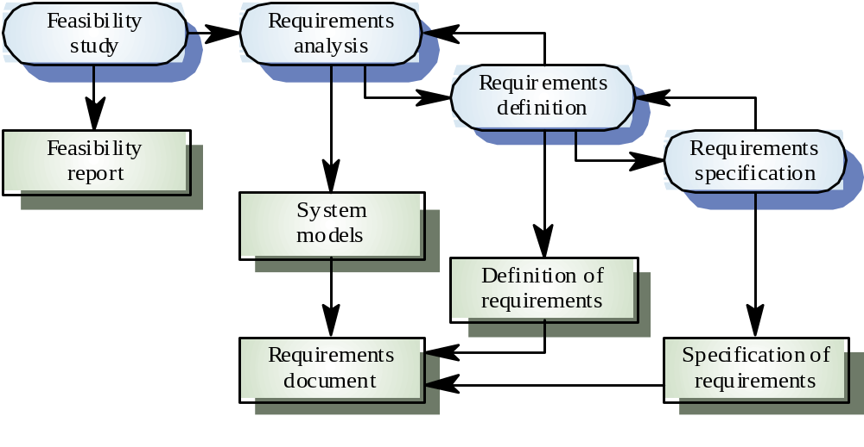
The RE process

Slide 10
The Requirements Document
The requirements document is the official statement of what is required of the system developers
Should include both a definition and a specification of requirements
It is NOT a design document. As far as possible, it should set of WHAT the system should do rather than HOW it should do it

Slide 11
Requirements document requirements
Specify external system behaviour
Specify implementation constraints
Easy to change
Serve as reference tool for maintenance
Record forethought about the life cycle of the system i.e. predict changes
Characterise responses to unexpected events

Slide 12
Requirements document structure
Introduction
  Describe need for the system and how it fits with business objectives
Glossary
  Define technical terms used
System models
  Define models showing system components and relationships
Functional requirements definition
  Describe the services to be provided

Slide 13
Requirements document structure
Non-functional requirements definition
  Define constraints on the system and the development process
System evolution
  Define fundamental assumptions on which the system is based and anticipated changes
Requirements specification
  Detailed specification of functional requirements
Appendices
  System hardware platform description
  Database requirements (as an ER model perhaps)
Index

Slide 14
Requirements validation
Concerned with demonstrating that the requirements define the system that the customer really wants
Requirements error costs are high so validation is very important
  Fixing a requirements error after delivery may cost up to 100 times the cost of fixing an implementation error
Prototyping is an important technique of requirements validation

Slide 15
Requirements checking
Validity. Does the system provide the functions which best support the customer’s needs?
Consistency. Are there any requirements conflicts?
Completeness. Are all functions required by the customer included?
Realism. Can the requirements be implemented given available budget and technology
Notes:
Why checking/validation of requirements?
Concerned with demonstrating that the requirements define the system that the customer really wants
Requirements error costs are high so validation is very important
Fixing a requirements error after delivery may cost up to 100 times the cost of fixing an implementation error
Prototyping (discussed in Chapter 8) is an important technique of requirements validation
Reviews
Regular reviews should be held while the requirements definition is being formulated
Both client and contractor staff should be involved in reviews
Reviews may be formal (with completed documents) or informal.
==> participative development, prototyping,
==> several abstraction levels of models, simple ones for customer
==> walkthroughs!!!! like with CRC-cards….

Slide 16
Types of Requirements
Functional requirements:
  input/output
  processing.
  error handling.
Non-functional requirements:
  Physical environment (equipment locations, multiple sites, etc.).
  Interfaces (data medium etc.).
  User & human factors (who are the users, their skill level etc.).

Slide 17
Types of Requirements (Cont.)
Non-functional requirements (continued):
  Performance (how well is system functioning).
  Documentation.
  Data (qualitative stuff).
  Resources (finding, physical space).
  Security (backup, firewall).
  Quality assurance (max. down time, MTBF, etc.).

Slide 18
Requirement Engineering Process
System Model:
Three types of system modeling exists.
Data Requirements leads to Data Modeling and we get ERD ( Entity Relationship Diagram )
Functional Requirements lead to Functional Modeling and we get DFD ( Data Flow Diagram ). It shows the information flow among various entities and functionalities.
Behavioral Requirements lead to Behavioral Modeling and we get STD ( State Transition Diagram)

